Slide 1
Group 8 - Project 9:
Housing Data

Slide 2
Agenda
Introduction to Our Data
Business Process - What are we trying to solve?
Technical Aspects
Visualizing Our Data
Monetizing Our Idea

Slide 3
Data Sets
How much does properties cost by county, address, the min, max, and average prices by property
Crime rate by county - violence, muder, rape, robbery, assault, burglary, and theft count
Living Wage, Average Salary,
Expenses
School
Sales, Properties
Crime
Information about private and public school in New York state that features class grade and ranks and ratio of pupil to teacher in the area.
How much does it cost to live in each county, what is the living wage and the median salary by profession

Slide 4
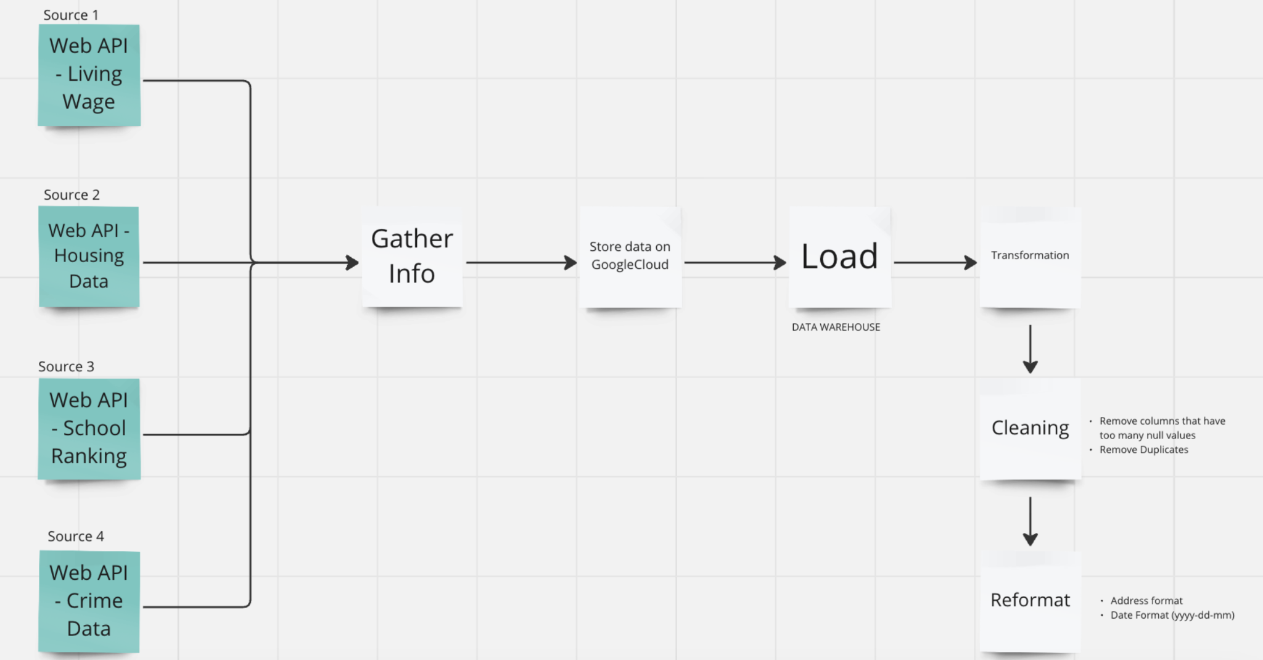
Information Architecture

Slide 5
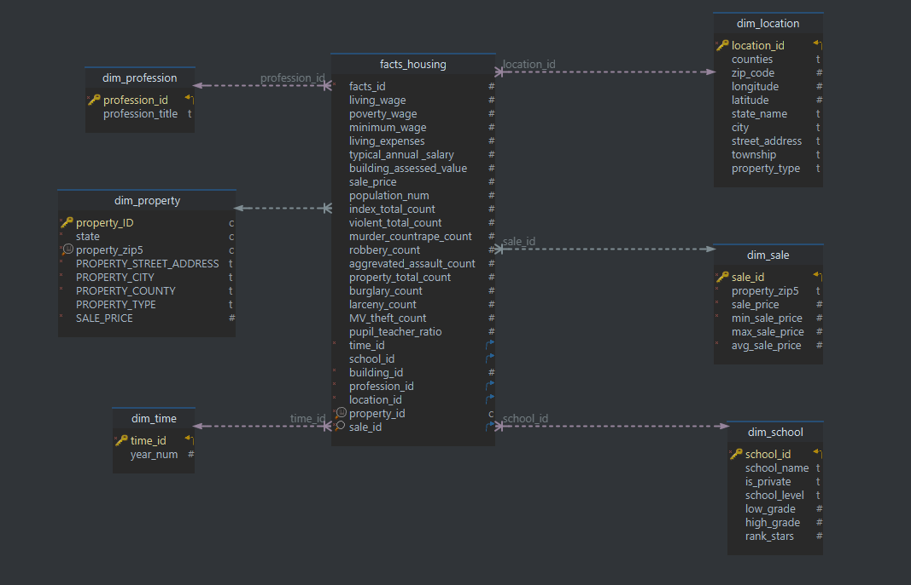
Data Modeling

Slide 6
ELT Process
Extracted data (Web Scraping)
Loaded data to Snowflake via (Python Script)
Transformation
Cleaned data (reformat date, remove null values and duplicates)
Created dim and fact tables
Populated data from original tables into our Dimensions and Fact Tables

Slide 7
Issues Encountered and How we Solved it
- How to work with json files on snowflake
- We were loading it without a table format, so in snowflake we were seeing only rows and no columns
- Went back to the python code that was loading the data into snowflake and made sure to create a table format for all sales data
- How to join all data sets in our Fact table
- When trying the “joins” in our four datasets we could not figure out how to make a connection between then
- To solve: we made sure all tables were linked to the dim_location and used the join based on “Counties”

Slide 8
Visuals

Slide 9
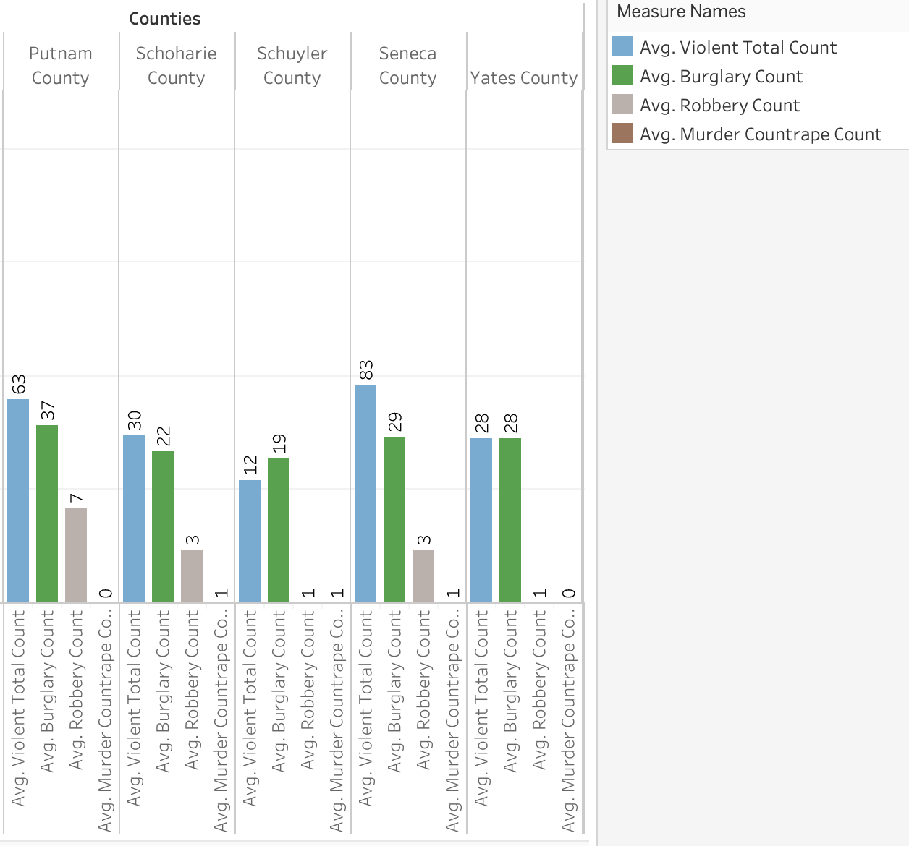
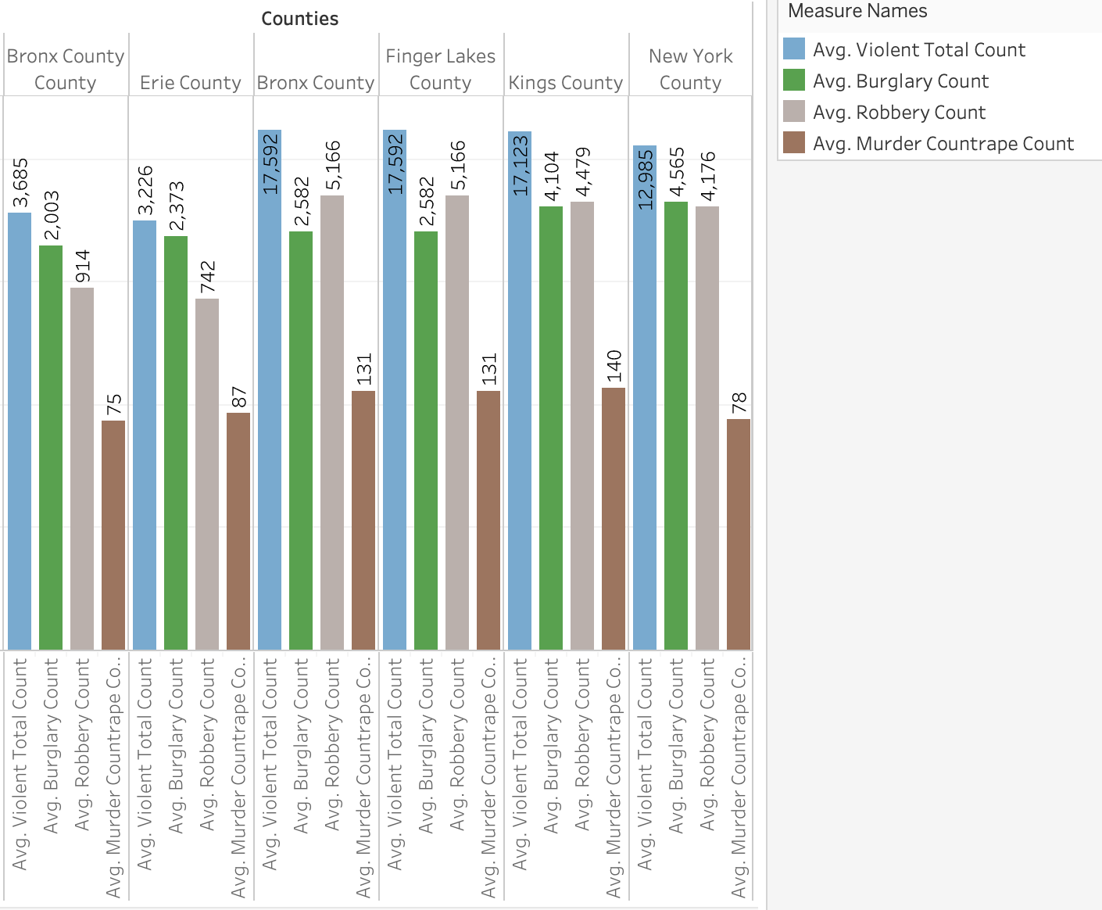
Crime Rate Visualization
The Avg. of total lowest crime Rate counties
The Avg. of total highest crime Rate counties

Slide 10
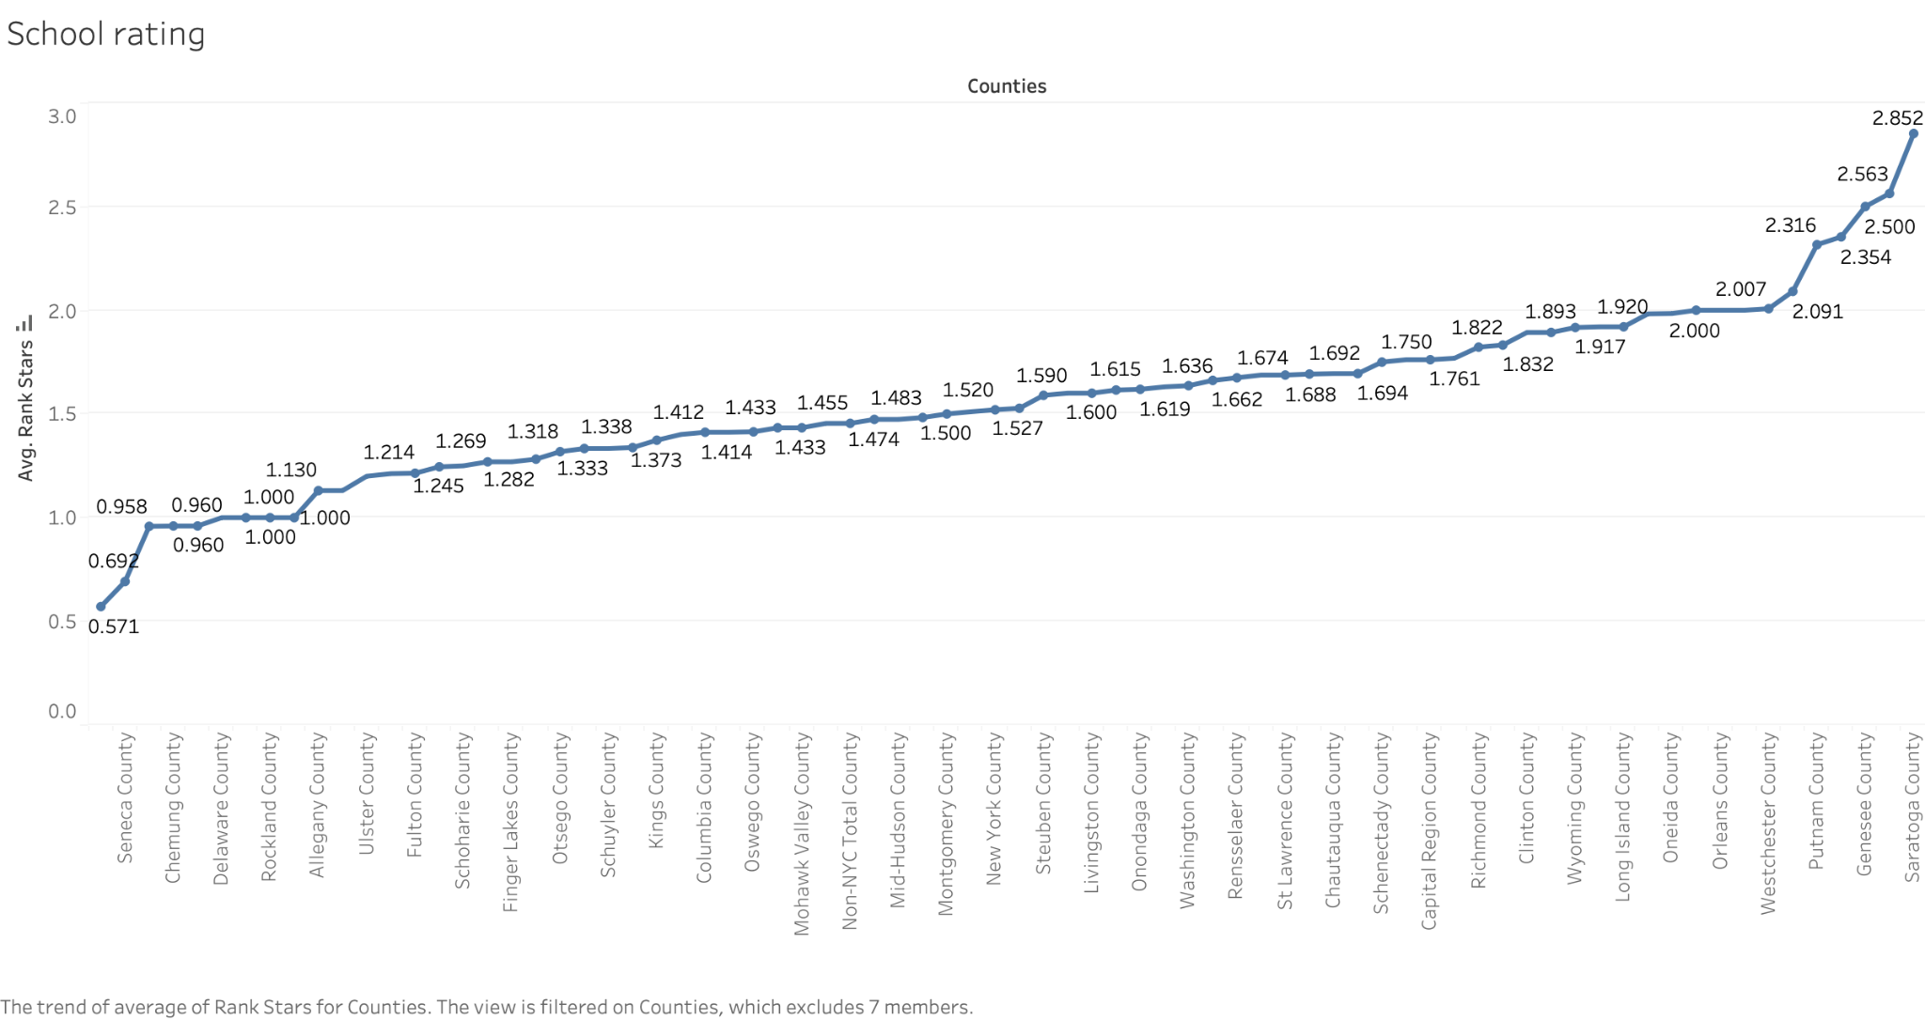
School Rank Visualization

Slide 11
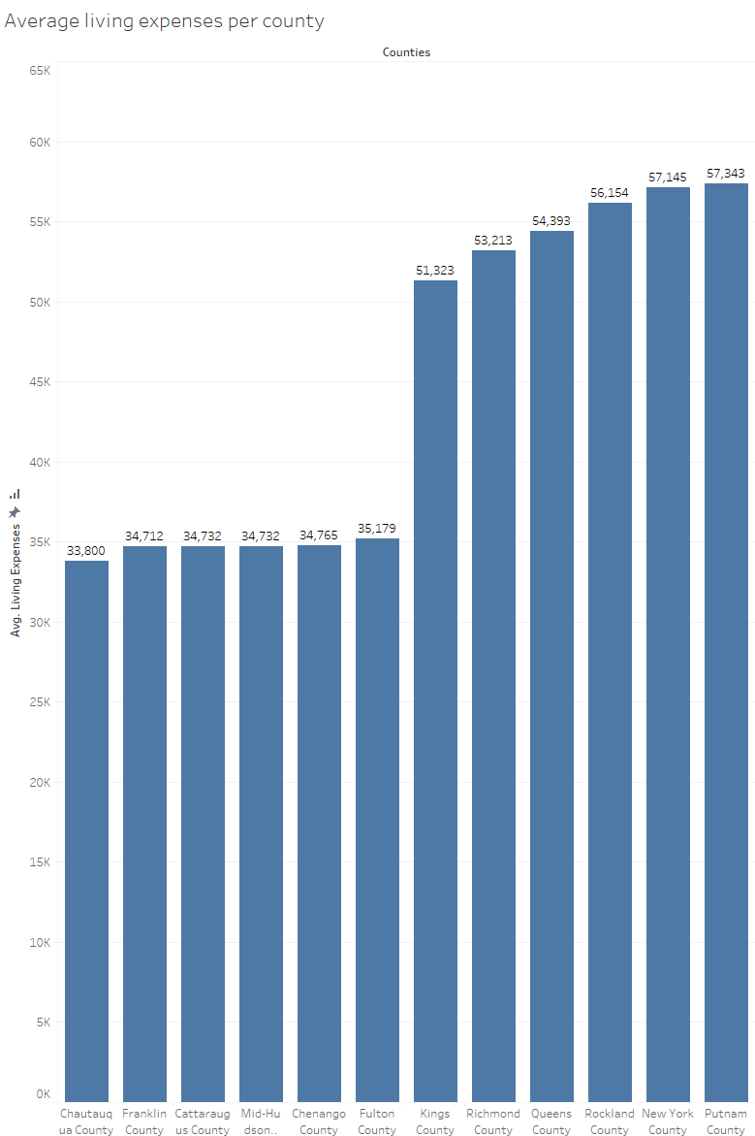
Cost of living by county
Chautauqua and Franklin Counties have the lowest cost of living
While Queens, Manhattan, and Putnam have the highest cost of living.

Slide 12
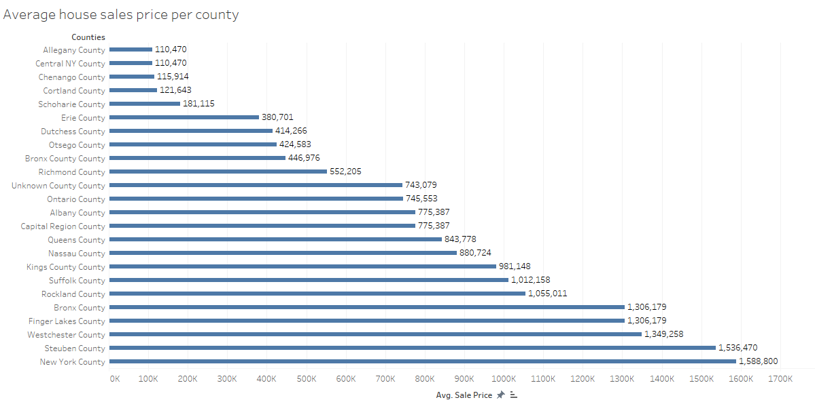
Average sales price of houses
Allegany County’s average sales price of houses is $110,470
Manhattan average sales price of houses is $1,588,800

Slide 13
How would we monetize it?
Cost of Infrastructure: $300/Month
Cost of Labor: $40,000/Month
Other costs: $5,000/Month
Zillow Real-Time Housing Price Subscription
Subscription Offer: $29.99/Month
Free Trial: 7 Days - approximately 10,000,000 users sign-up for the trial
Subscribers After Trial: 200,000
Monthly Revenue: $6,000,000
Total Revenue generated in a year: $72,000,000
Total Cost: infrastructure, labor, miscellaneous and zillow share (5%)
Annual Profit (After Zillow's Share): $67,883,580

Slide 14
References
https://livingwage.mit.edu/counties/13151
https://www.dolthub.com/repositories/dolthub/us-housing-prices-v2/data/main/sales
https://www.mylocalcrime.com/?kbid=62750#40.732326%2C%20-73.25099
https://developer.schooldigger.com/

